Slide 1
Shifting Between Worlds: XR, The Metaverse, and Normative Zones of Experience
Jordan Kokot, Boston University
Email: jdkokot@bu.edu
Website: www.jdkokot.com

Slide 2
Outline
Introduction & Background: XR, Phenomenology, & Agency
Worlds & Realities: Alfred Schütz on the “Finite Provinces of Meaning”
Cognitive Styles, Liminality, and VR: A framework for thinking through the transitional aspects of Virtual Reality
VR, The Metaverse, & the “Existential Hangover”

Slide 3
XR, Phenomenology, & Agency
Foundational Questions:
How can we characterize the radically different cognitive, dispositional, and normative capacities we exhibit in different worlds? How can we understand the various ways we transition between worlds?
How do our experiences in different worlds inform each other? What persists between shifts in worlds, and what changes?
What are the effects of these transitions? How do they influence the development of persons who frequently shift between worlds? What are the broader social implications of frequent world shifting?

Slide 4
XR, Phenomenology, & Agency
XR Specific Ethical Concerns:
Changing relationships to objects (cognitive offloading)
Changing relationships with the natural world (Environmental Justice/Control Fetishism)
Changing relationships with each other (avatars and filters)
Racial bias, lookism, and gender discrimination
Gamification/metric manipulation
Behavior and value manipulation—perhaps more directly than any other emerging technology, XR has the potential to directly change our systems of value. This is especially concerning given how current technologies are unregulated and controlled by dubious corporate actors.

Slide 5
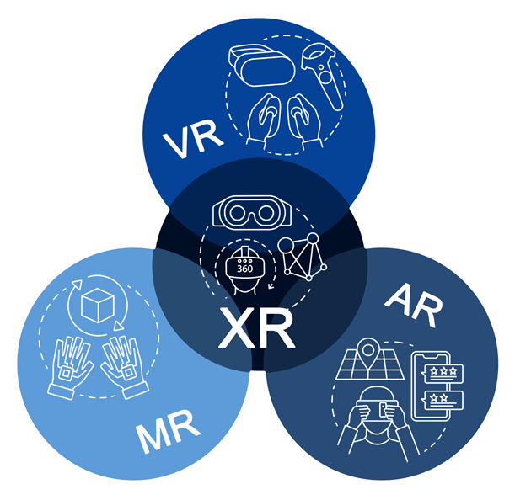
XR, Phenomenology, & Agency
Definitions
XR/VR/AR/MR: Technologies that allow users to enter a virtual world space, or insert virtual objects into an existing world space
World/Reality: a (mostly) self-contained system of expectations, potentials for action, and experiences, governed by its own rules. Usually highly visual, if not also spatial.
Transitional Object/Transitional Agent: a virtual object that appears in a non-virtual world, or a virtual modification of a non-virtual object.

Slide 6
“Game designers do not simply create worlds; they design temporary selves. Game designers set what our motivations are in the game and what our abilities will be... the fact that we play games shows something remarkable about us. Our agency is more fluid than we might have thought. In playing a game, we take on temporary ends; we submerge ourselves temporarily in an alternate agency”
-C. Thi Nguyen, Games: Agency as Art

Slide 7
“We call a certain set of experiences a finite province of meaning if all of them show a specific cognitive style and are – with respect to this style – not only consistent in themselves but also compatible with one another...To the cognitive style peculiar to each of these different provinces of meaning belongs, thus, a specific tension of consciousness and, consequently, also a specific epoché, prevalent form of spontaneity, a specific form of self experience, a specific form of sociality, and a specific time perspective.”
-Alfred Schütz, “On Multiple Realities”

Slide 8
Technological Mediation: There is no “pre-given subject in a pre-given world of objects, with a mediating entity between them. Rather, the mediation is the source of the specific shape of that human subjectivity and the objectivity the world can take…Technologies, to be short, are not opposed to human existence; they are its very medium.” -Robert Rosenberger & Peter-Paul Verbeek

Slide 9
Part 2:
Worlds & Realities: Alfred Schütz on the “Finite Provinces of Meaning”

Slide 10
“Hence we call a certain set of our experiences a finite province of meaning if all of them show a specific cognitive style and are – with respect to this style – not only consistent in themselves but also compatible with one another…”
“…To the cognitive style peculiar to each of these different provinces of meaning belongs, thus, a specific tension of consciousness and, consequently, also a specific epoché, prevalent form of spontaneity, a specific form of self experience, a specific form of sociality, and a specific time perspective.”

Slide 11
Worlds & Realities: Alfred Schütz on the “Finite Provinces of Meaning”
Cognitive Styles: “As an example let us consider again the world of everyday...This world is certainly a “sub-universe” or “finite province of meaning” among many others, although one marked out as ultimate or paramount reality...If we recapitulate the basic characteristics which constitute its specific cognitive style we find:
a specific tension of consciousness, namely wide-awakeness, originating in full attention to life;
a specific epoché, namely suspension of doubt
a prevalent form of spontaneity, namely working...
a specific form of experiencing one’s self (the working self as the total self)
a specific form of sociality (the common intersubjective world of communication and social action)
a specific time-perspective (the standard time originating in an intersection between durée and cosmic time as the universal temporal structure of the intersubjective world).

Slide 12
Part 3:
Cognitive Styles, Virtual Reality, & Liminality

Slide 13
Liminality, Lacuna, & Virtual Reality
Transition Functions characterize how Schutz six aspects of cognitive style appear across worlds. These styles constitute “Normative Zones of Experience”
Cognitive Style
Virtual World
(Flight Simulator)
“Real” World
(flying a Plane)
Tension of Consciousness
Epoché
Form of Spontaneity
Form of Experiencing One’s Self
Form of Sociality
Time-Perspective
Task focus, immediacy, immersion
Bracketing external concerns/epistemic immediacy. Virtual.
Response to immediate stimuli, non-anxious
As a pilot*
Virtual intersubjective world
Governed by the needs of the moment. Virtual (Repeatable)
Task focus, immediacy, immersion
Bracketing external concerns/epistemic immediacy
Response to immediate stimuli, anxious
As a pilot
Full intersubjective world
Governed by the needs of the moment. Non-repeatable
When the pilot* leaves Flight Simulator, they bring with them memories, skills and affordances, epistemic structures, and emotions and moods. These then inform and structure the cognitive style they take on when actually flying a plane. But they do not keep the same time perspective.

Slide 14
“...Even more, this reality seems to us to be the natural one, and we are not ready to abandon our attitude toward it without having experienced a specific shock which compels us to break through the limits of this “finite” province of meaning and to shift the accent of reality to another one...”
“...To be sure those experiences of shock befall me frequently amidst my daily life; they themselves pertain to its reality. They show me that the world of working in standard time is not the sole finite province of meaning but only one of many others accessible to my intentional life...”

Slide 15
Liminality, Lacuna, and Virtual Reality
Transition Function: Each form of liminality allows for transitions between zones in different ways. Three basic categories of this function are directness, immediacy, and domain
Directness: a form of liminality can either be direct or indirect in terms of its causal relationship to the new world and the starting world (essentially maps onto the thematic/non-thematic distinction)
Immediacy: a form of liminality can be either immediate or mediated in terms of how it shows up in a world other than what it started in
Domain: a form of liminality can be either situational, in that it can be directly applied to multiple worlds, transcendent, in that it carries over to the next world almost automatically, or it can be universal in that, once uncovered, it applies to all worlds.

Slide 16
Six Forms of Liminality
 | Overview | Design Decisions | Transition Function | Example
Direct Memory | generate and manipulate memories | Repetition, Goal Manipulation | Direct, Immediate, Transcendent | Shadow of the Colossus (2005)
Skills & Affordances | require users to develop and deploy skills and dispositions | UI Design, Repetition, World Design, Physics Models, Puzzles | Indirect, Immediate, Situational | Microsoft Flight Simulator (2022)
Epistemic Structures | generate beliefs, some of which transcend | Direct Instruction, Problem Solving | Direct, Mediated, Situational | Educational Software
Emotions & Moods | generate moods and emotions that carry over | Narrative, Filmic Elements, Agency Manipulation | Direct, Immediate, Transcendent | That Dragon, Cancer (2016)
Social Ties | can create trans-world relationships | Avatar Design, Communication Modality, Economy | Indirect, Mediated, Situational | Metaverse/Social Media/MMORPGs
Transcendental | reveal basic structures of worlds and self | Narrative, Structural, Temporal | Direct?, Immediate, Universal | The Outer Wilds (2019)

Slide 17
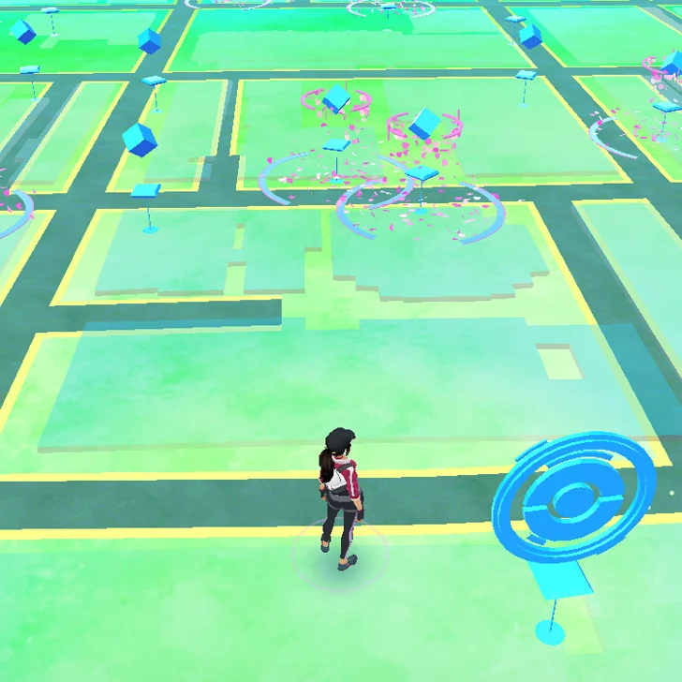
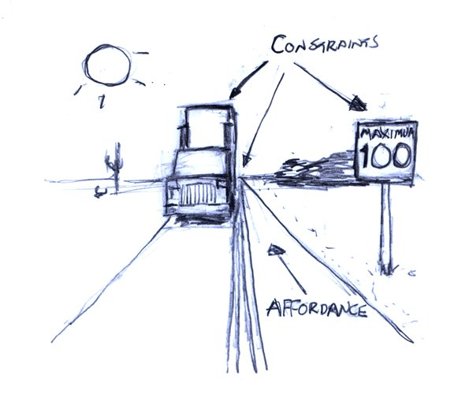
VR Designers as “Affordance Engineers”
Affordances: “What an environment offers the individual” in terms of meaningful or viable choices.
All technologies create new affordances because they mediate between users and their environment. In mediating, they change our values, dispositions, and sedimented emotional structures by changing what is available for action and directing our goals.
World designers are “affordance engineers”—they create worlds which are designed to produces specific kinds of goals, actions, and dispositions among its inhabitants.
They also create transitional objects and experiences—design decisions don’t just change the world being designed, but have a lasting influence on user/world dynamics in general

Slide 18
VR, XR, & the “Existential Hangover” Depersonalization, Derealization, and Control Ontology
“What stays is a strange feeling of sadness and disappointment when participating in the real world, usually on the same day...The sky seems less colorful and it just feels like I’m missing the ‘magic’ (for the lack of a better word). … I feel deeply disturbed and often end up just sitting there, staring at a wall.” (Searles, 2016, Quoting Tobias van Schneider)
“Less a feeling of depression...and more a sense of detachment”
“[W]hile standing and in the middle of a sentence, I had an incredibly strange, weird moment of comparing real life to the VR...I understood that the demo was over, but it was [as] if a lower level part of my mind couldn’t exactly be sure. It gave me a very weird existential dread of my entire situation, and the only way I could get rid of that feeling was to walk around or touch things around me.”
Proposal: We can understand the depersonalization and the derealization often described by VR users as a result of how VR radicalizes and problematizes the ordinarily more predicable and fluid transitions between worlds. VR often creates a sense of control, specifically over time, and the sudden reconfiguration of affordances and loss of that control puts pressure on embedded senses of self and world.

Slide 19
Thank you Contact: Jdkokot@bu.edu Website: www.jdkokot.com

Slide 20
We are not saying that time exists for someone...We are saying, rather, that time is someone or, in other words, that the temporal dimensions – insofar as they perpetually fit together – affirm each other, never do more than make explicit what was implied in each one, and each express a single rupture or a single thrust that is subjectivity itself. Time must be understood as the subject, and the subject must be understood as time”
-Maurice Merleau-Ponty, The Phenomenology of Perception

